Slide 1
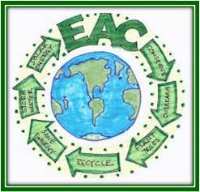
HAVERFORD TOWNSHIP ENVIRONMENTAL ADVISORY COMMITTEE
Plastic Pollution Reduction Municipal Options / Proposed Rule
February 7, 2022

Slide 2
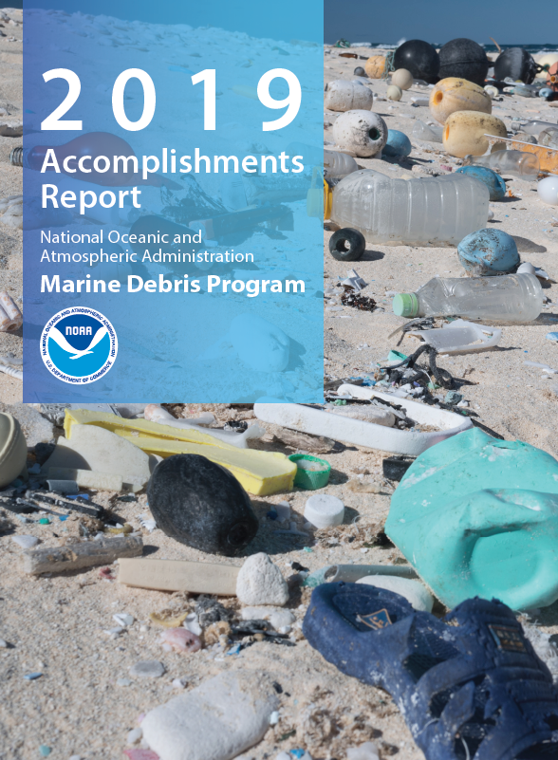
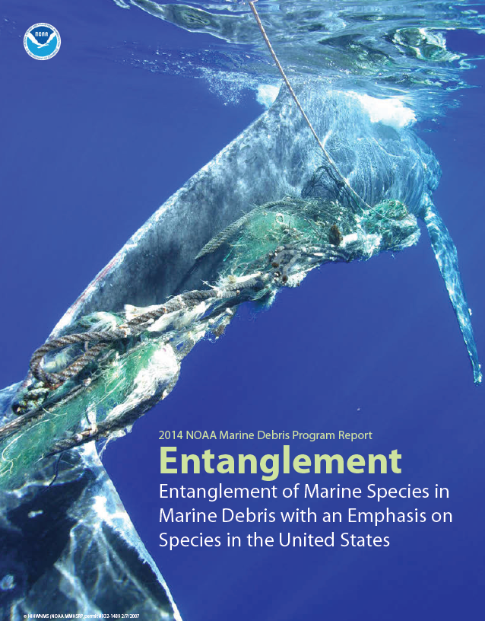
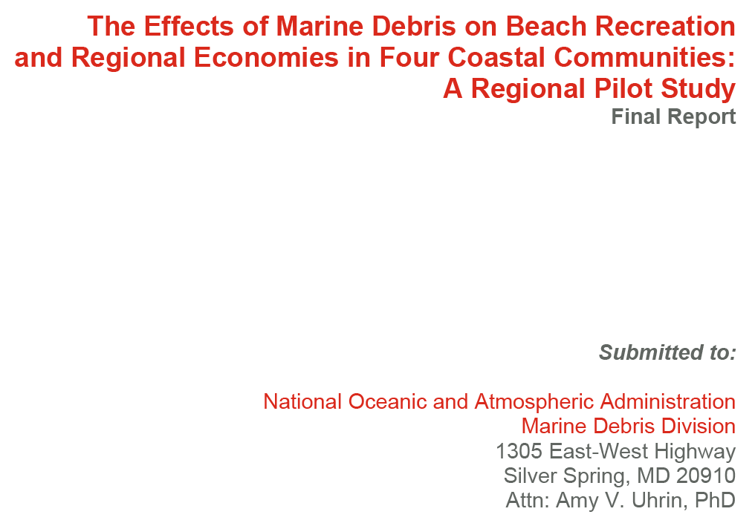
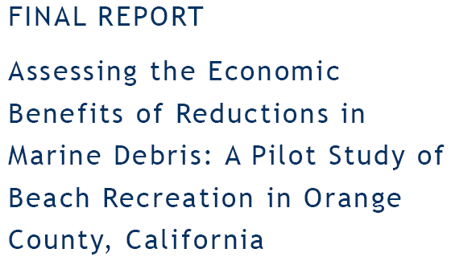
Costing Marine Life, Costing Us
NOAA & many US and international organizations https://marinedebris.noaa.gov/reports-and-technical-memos

Slide 3
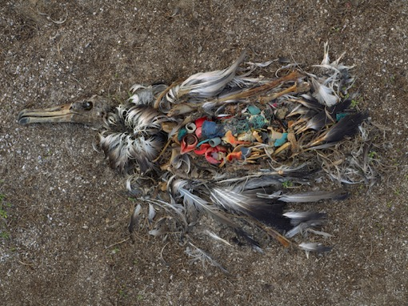
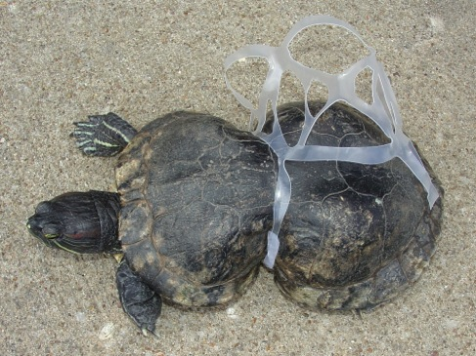
Source:
Surfrider San Diego Rise Above Plastics;
https://sandiego.surfrider.org/wp-content/uploads/2013/04/RAP.ppt
Thousands of marine mammals and sea birds die every year after ingesting or being tangled in plastic marine litter.
Notes:
One of the top reasons people are inspired to tackle plastic pollution is because of the impacts to wildlife.
Top left is a photo from Chris Jordan that he took on uninhabited Midway Atoll in the middle of the Pacific, halfway between California and Japan. Laysan albatross are dying from plastic pollution at an alarming rate.
Top right is a photo from Missouri and a great example of why we need to cut up six-pack rings, or better yet avoid them all together. (Fridge packs)

Slide 4
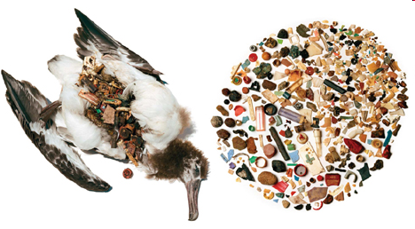
All of this debris on the right (more than a half-pound of plastic) was removed from the stomach of an albatross on remote Midway Island in Hawaii
Source: Surfrider San Diego Rise Above Plastics;
https://sandiego.surfrider.org/wp-content/uploads/2013/04/RAP.ppt
Notes:
Albatross are sea birds with a HUGE wingspan. They get their dinner by skimming for fish at sea.
Like many sea birds, this albatross couldn’t tell the difference between our plastic trash, and it’s food.
Here, you can see the result…
This particular albatross was found dead with more than half a pound of plastic in it’s stomach.
Ultimately, the birds may end up dying from starvation and malnutrition because their bodies become “full” on plastics that they can’t process.
An estimated 5 tons of plastic per year brought to Midway Atoll by lays an albatross to feed their chicks.

Slide 5
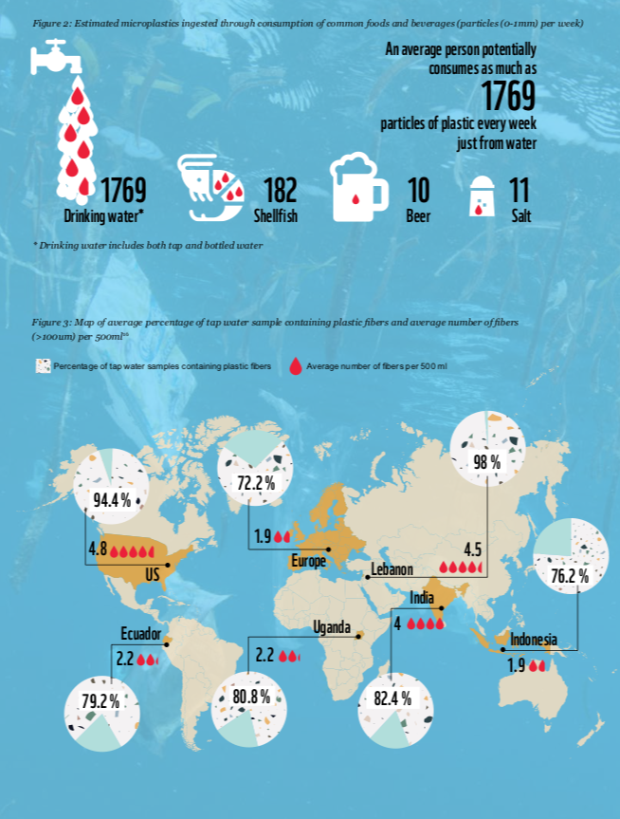
What We are Eating/Drinking
Particles of microplastics
(0-1 mm) consumed per week
% of Water Samples Containing Plastic Fibers
# of Fibers per 500 ml
https://d2ouvy59p0dg6k.cloudfront.net/downloads/plastic_ingestion_web_spreads_1.pdf

Slide 6
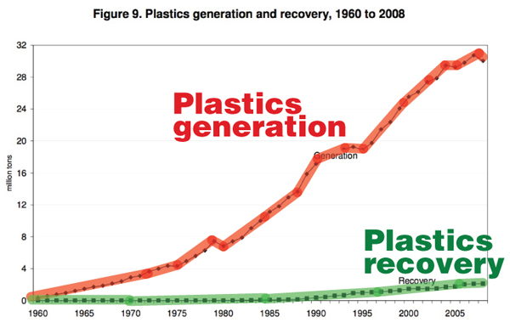
We Can’t Recycle Our Way Out
Source: Surfrider San Diego Rise Above Plastics; Data from CalRecycle
https://sandiego.surfrider.org/wp-content/uploads/2013/04/RAP.ppt

Slide 7
Role of Single Use Plastic Bags
What is the problem and the role of Single Use Plastic Bags (SUPG)
Definitions
Examples of local ordinances and where implemented
How effective they have bans and bag taxes been
EAC recommendations
ULTIMATE GOALS:
Reduce our contribution to plastics pollution in our community and waterways, reduce human and animal ingestion of plastics and contribute to regional, state and global solutions

Slide 8
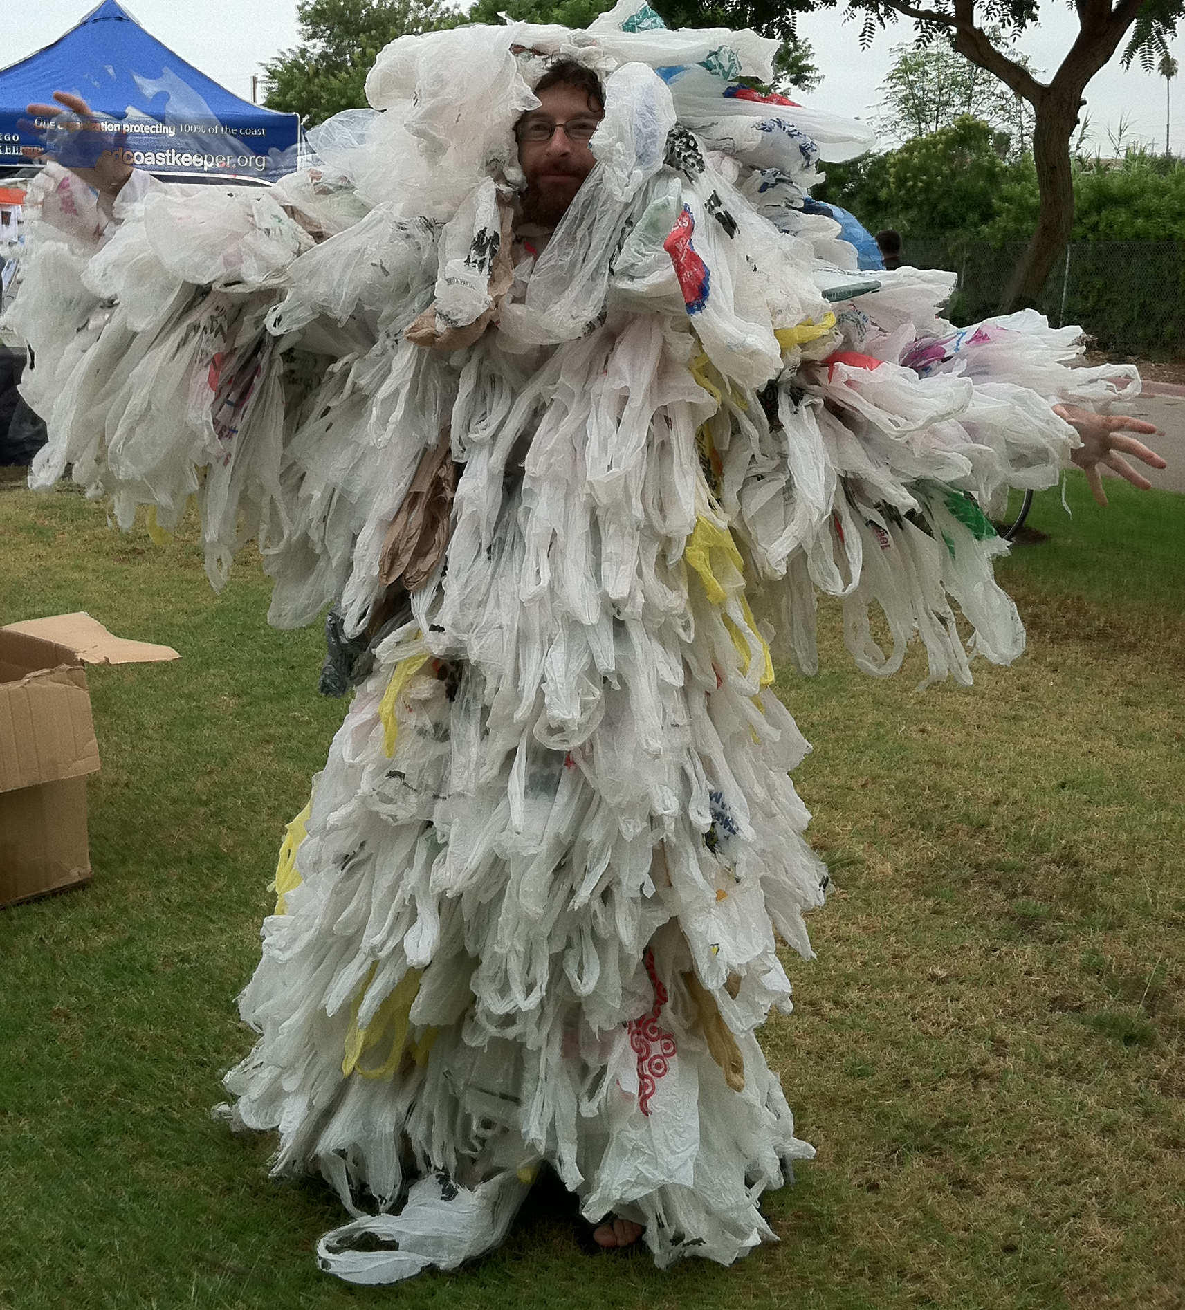
Definitions
Single Use Plastic Bag (SUPB): a bag made of thin plastic intended for only one use, then disposal
Reusable Bag: a bag made of cloth or other durable fabric and is designed and intended for multiple uses
Fee: Any charge collected by a business in exchange for a SUPB that is given to a patron
Source: San Diego Coastkeeper https://www.sdcoastkeeper.org/blog/uncategorized/4547/attachment/travis-as-plastic-bag-monster_ccd-2011

Slide 9
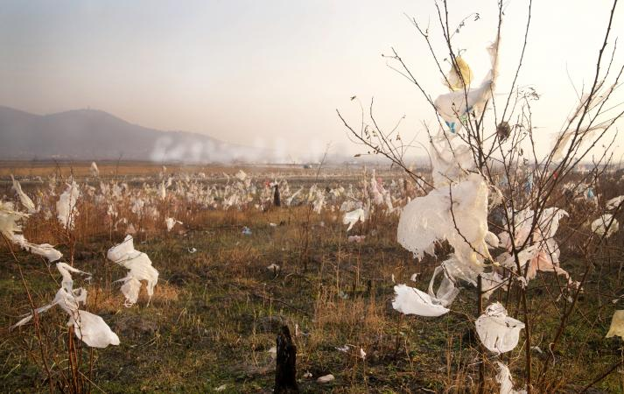
A Few Plastic Facts
~5-13 million tons of plastic enter oceans each year from land
In 2015, of ~730,000 tons of high density poly-ethylene (HDPE) plastic “bags, sacks and wraps” waste in the US, only 5.5% recycled
Plastics do not biodegrade, but break up into small particles that persist in the ocean, adsorb toxins, and enter the food chain
Most “bioplastics” persist just like petroleum-based plastic
Commonly used plastics, when exposed to elements, release methane and ethylene greenhouse gases
See beachapedia.org/Plastic_Pollution_Facts_and_Figures for primary references

Slide 10
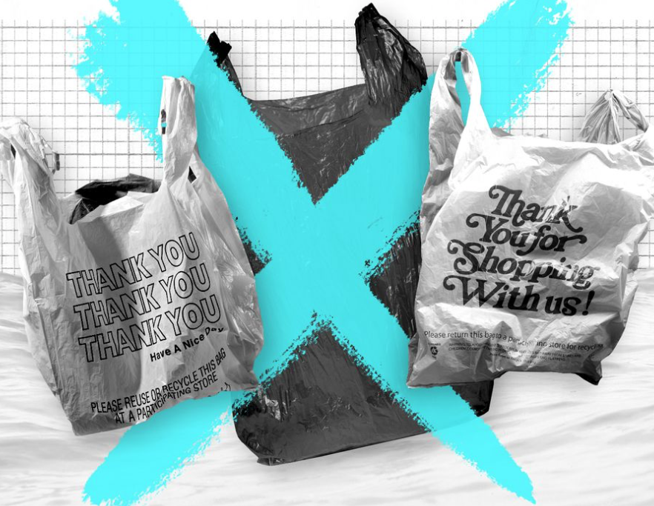
A Few Plastic Facts
Majority of encounters of marine debris reported involving impact to 663 marine wildlife species with plastic debris
Plastic bags (resembling jellyfish) are the most common synthetic in sea turtles’ stomachs, and 34% of dead leatherbacks ingested plastic
80% of seabird species have plastic in their stomachs
A study found $520,000,000 – over one half billion dollars – each year spent on the west coast alone to combat litter and curtail marine debris
See beachapedia.org/Plastic_Pollution_Facts_and_Figures for primary references

Slide 11
10 Facts About Single-use Plastic Bags
Americans use 100 billion plastic bags/yr, requires 12 million barrels of oil to make.
14 plastic bags uses the equivalent of gas required to drive one mile.
Average American family takes home ~1,500 plastic shopping bags a year.
Only 1 % of plastic bags are recycled, the average family only recycles 15 bags a year; the rest end up in landfills or as litter (according to Waste Management,)
Up to 80 percent of ocean plastic pollution enters the ocean from land.
At least 267 different species have been affected by plastic pollution in the ocean.
100,000 marine animals are killed by plastic bags annually.
One in three leatherback sea turtles have been found with plastic in their stomachs.
Plastic bags are used for an average of 12 minutes.
It takes 500 (or more) years for a plastic bag to degrade in a landfill. Unfortunately the bags don't break down completely but instead photo-degrade, becoming microplastics that absorb toxins and continue to pollute the environment.

Slide 12
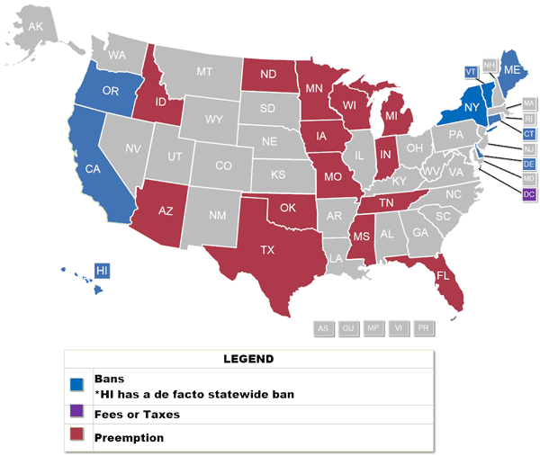
Single Use Plastic Bans by State - 2019
Sourcehttps://www.ncsl.org/research/environment-and-natural-resources/plastic-bag-legislation.aspx

Slide 13
State Action Examples https://www.ncsl.org/research/environment-and-natural-resources/plastic-bag-legislation.aspx
CT - $.10 fee for 2 years then ban starting July 2021
DE – requires in store recycling. Limits SUPB usage.
CA – bans SUPB for large retail; $.10 minimum fee for recycled paper/reusable plastic/compostable bags
DC – bans SUPB, fee for all other disposable bags distributed, establishes Anacosta Protection Fund
15 States have “banned bans” (prevents local laws)
8 states plus DC have enacted bans

Slide 14
Municipal Action Examples https://www.ncsl.org/research/environment-and-natural-resources/plastic-bag-legislation.aspx
Narberth, PA 2018 (bags and straws) $0.10 fee
West Chester, PA 2019 – ban and $0.10 fee
Philadelphia, PA - fee
Media and Easttown now considering ban/fee
9 other “large cities, e.g., Chicago, LA, SF, Boston, NY...
San Jose, Santa Monica, Richmond, CA: $0.20 fee
Aspen CO
Summary
https://www.ncsl.org/research/environment-and-natural-resources/plastic-bag-legislation.aspx

Slide 15
PA History /Recent “Hold” on Local Bans
History of Pennsylvania Law
Gov. Wolf vetoed a 2017 legislation to strike down a proposal that would have pre-empted local restrictions on plastic bag use http://www.pennlive.com/news/2017/06/gov_tom_wolf_to_ban_state_ban.html
June 2019 & 2020, Gov. Wolf signed budget bills w/rider prohibiting municipal bans or taxes on plastic bags or packaging for one year while legislative agencies study the economic and environmental impact https://www.centredaily.com/news/local/article232101147.html
2021: Philadelphia and other municipalities sue PA citing ban rider to budget is not constitutional
July 1, 2021 ends state 1 year ban provisions

Slide 16
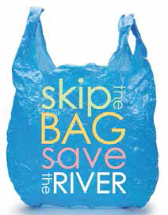
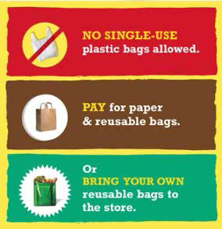
Which Bag Laws Work?
3 Approaches – 2 Recommended, 1 Less Effective
Ban Fee on All Bags Ban/Fee Hybrid (shifts to paper)
Source: Surfrider Toolkit (http://publicfiles.surfrider.org/Plastics/Plastic_Bag_Law_Activist_Toolkit_2019.pdf)

Slide 17
Which Bag Laws Work Best?
Ban/Fee Hybrid - San Jose, CA: Ban on SUPBs +10-cent fee on paper cut river bag litter by 2/3, in neighborhoods by 1/2. Reusable bag use from 4% to 62%, “no bag” from 19% to 43%. Recycling machine down time cut by 1/2.
Ban/Fee Hybrid – Alameda Co., CA: Ban on SUPBs + fee on paper / reusables led to 80% less single-use paper and plastic bags, 200% more reusable bags or “no bag”, 44% less SUPBs in storm drains
Fee Only - Chicago: 7-cent fee cut SUPB use at supermarkets 42%, increased reusable use by 20%, increased “no bag” by 12%.
Ban Only – San Francisco: 2007 law found less effective, stores switched to paper, a lot of double bagging.
Ban Only - In Westport, CT: 50% used “reusable” bags (including thicker plastic bags), 45% paper bags, and 2% no bag
Takeaway: Fees on All Bags and Ban/Fee Hybrids laws most effective at reducing overall SUPB consumption by changing consumer behavior
Source: Surfrider Toolkit (http://publicfiles.surfrider.org/Plastics/Plastic_Bag_Law_Activist_Toolkit_2019.pdf)

Slide 18
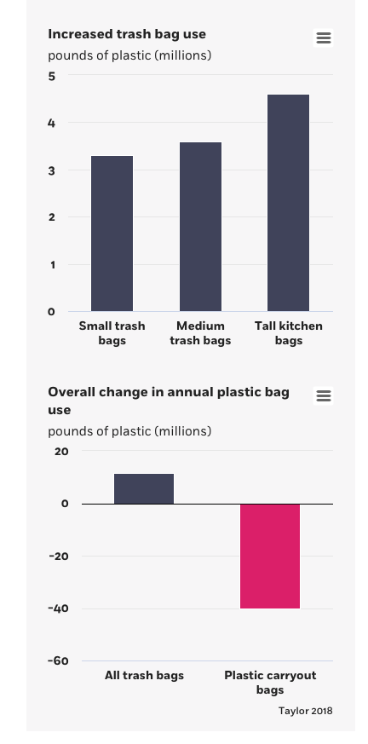
Chicago reported some higher garbage bag purchases due to those reusing SUPBs https://review.chicagobooth.edu/economics/2019/article/why-banning-plastic-bags-doesn-t-work-intended

Slide 19
Narberth Bag Fee / Plastic Straw Ban https://www.ecode360.com/NA0447/laws/LF1057727.pdf
Passed by unanimous vote in October 2018
Survey showed large community support
92% of people supported reducing use of plastic bags
79% supported ban on single use bags
49% supported $0.10 fee on plastic bags
$0.10 fee on SUPBs retained by the business
Plastic straws banned unless requested / disability
Reusable/paper/compostable allowed -no fee directive
Exempts only nonprofit bazaars or festivals.

Slide 20
West Chester Hybrid Ban/Fee
Passed the Borough Council by a 4-3 vote in 2019
Implementation Jan. 1, 2022 (delayed by PA Ban):
Bans all SUPGs and plastic straws.
$0.10 fee for each “compliant” bag distributed. Must be ≥4 mil reusable or paper with ≥40% recycled content and fully compostable (i.e., no plastic)
Fine of $100+, for violation. 1 year extension on appeal to evaluate impact
Hardship requests allowed; straw exception for disability
Also applies to takeout deliveries
https://west-chester.com/DocumentCenter/View/10486/Chapter-81-Plastic-Bag-and-Plastic-Straw-Regulations--July-17-2019?bidId

Slide 21
Philadelphia Bag Ban https://www.phillyvoice.com/philadelphia-plastic-bag-ban-single-use-no-fee-2020-city-council-squilla/
Estimated to save $9 million in cleanup cost, portion of current 1 billion SUPB/yr
Council passed 2/10/19; effective 10/1/21; enforced 4/1/22
Supermarkets, convenience stores, gas stations, dep’t stores, dollar stores, clothing, restaurants, food trucks, farmers' markets, and delivery services
Exempts dry cleaners, does not affect “wrapping” or bags for fruit, etc. before bagging at the final point of sale.
Ban only – all <2.25 mil or blown-film extrusion process bags
Proposed $0.15/bag fee on bags was dropped – expected to reduce reuse performance, simply shift to paper
Bill includes a provision to study outcomes

Slide 22
Pros and Cons for Retailers
Retailers save money if people bring their own bags.
No longer willing to contest these laws, don’t want to look like the bad guys but happy to reduce costs when most shoppers bring their own bags.
Generally happy if they are able to charge a fee that covers the cost of the bags they provide.
Supermarkets voluntarily selling reusable bags / charging for single use bags for years; now trickling down (e.g. Wawa)

Slide 23
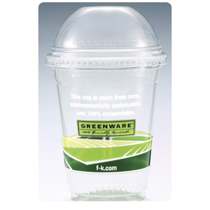
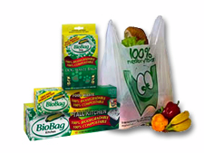
Don’t Exempt Biodegradeable/Compostable
These are not YET the answer (maybe some day).
Contaminate ‘regular’ plastics recycling if mixed in
No standard for use of “biodegradable” or “compostable”
“Compostables” require INDUSTRIAL COMPOSTING to biodegrade (140ºF and fed microbes)
“Photodegradeables” – only degrade if “ideal conditions” and make micro-plastic particles
Do not biodegrade in water or when littered, acts like ‘regular’ plastics and photodegrade.
Notes:
Biodegradeable plastics are one example of redesigning common product using materials made with renewable resources.
While bioplastics are a step in the right direction, they are not the answer.
Unless that bioplastic makes its way to an industrial composter – that reaches at least 140 degrees Fahrenheit – the chances are that it’s not breaking down
And bioplastics do NOT break down in the ocean or when littered on land! I generally think of them as regular plastics at the end of the day.

Slide 24
Recommendations
Best choice is Hybrid Ban / Fee (e.g., West Chester)
2nd Best is Fee only – transitional (e.g., Narberth)
NOT Recommended – Ban only (e.g., Philadelphia) because it is shown NOT to encourage bag reuse
Also Consider:
1 year to Effective Date to allow retailer preparation
Resolution calling for state-wide Hybrid/Ban
Work with HPED on transition and tools for small businesses, e.g.:
Standard “Buy Local” bag reusable bag design with negotiated pricing)
Possibly Sponsor an initial bag purchase allocated to those who attend information session.

Slide 25
Notes on 2020 to 2022 Updates
Changes tracked / Explanatory Notes in MS Word doc
Reusable bag definition better matches those reused by consumers.
Added “compliant straw”, certified compostable, to eliminate the need to provide an exception to request a plastic straw
Fee from fixed $0.10 to “a minimum of $0.15” per compliant bag in recognition of actual costs. This allows stores to charge more if they so choose and further promotes consumer selection of reusable bags

Slide 26
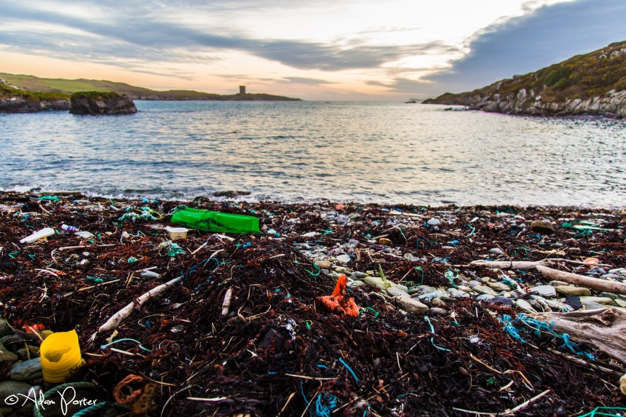

Slide 27
Resources
http://publicfiles.surfrider.org/Plastics/Plastic_Bag_Law_Activist_Toolkit_2019.pdf
https://www.vox.com/the-highlight/2019/8/20/20806651/plastic-bag-ban-straw-ban-tax
https://greenliving.lovetoknow.com/Are_Plastic_Shopping_Bags_a_Problem_in_Our_Environment
https://www.biologicaldiversity.org/programs/population_and_sustainability/sustainability/plastic_bag_facts.html
https://d2ouvy59p0dg6k.cloudfront.net/downloads/plastic_ingestion_web_spreads_1.pdf
Narberth Ordinance: https://www.ecode360.com/NA0447/laws/LF1057727.pdf

