Slide 1
Save and Preserve Oakwell: Ecological connections and ecosystem services under threat
DCVA Annual Meeting
Joe MacNeal
Preserve Oakwell volunteer
Notes:
Personal background: I’m a resident of Ardmore and a Penn Wynne Elementary School parent of two children, now in 4th grade and 1st grade, both who will be attending Black Rock Middle School. I’m also a founding member of a PHS Tree Tender group called Ardmore Tree Stewards, member of the LMT Shade Tree Commission, I’m a Pennsylvania Master Naturalist, and in training to become a Penn State Master Watershed Steward
This is the wrong development for this site. I have some comments on why.

Slide 2
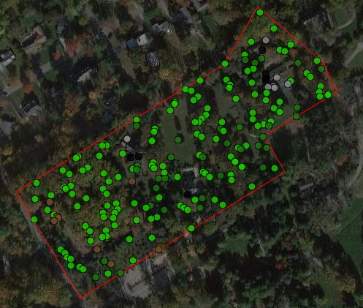
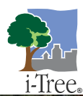
Tree Canopy Assessment and Benefits
72% tree canopy & shrubs
14 tons of carbon sequestered annually by trees on site
360 tons of carbon stored in existing trees
Site removes 785lbs of air pollution annually
Current-state includes thousands of gallons in hydrological benefits each year
Notes:
I used the U.S. Forest Service’s iTree canopy tool to plot 200 data points in the Oakwell shape file, and calculate the benefits provided by this site.
72% tree canopy & shrubs
17% grass/ herbaceous
Hydrological benefits include avoided runoff, evaporation, interception, and transpiration.
The site currently includes an incredible amount mature trees presumably well over 100 years old. The species includes some of our largest and most important native tree species and genera: white oaks, red oaks, pines, native maples, Eastern hemlock, tulip tree, black cherry, bald cypress, American holly, basswood, Kentucky coffee tree as well as significant stands of spicebush and native rhododendron. The vast majority of trees on site are healthy from visual inspection. A large amount of trees on site would meet neighboring municipalities’ definition of Heritage trees – take one Heritage tree and multiply it by something like 100 Additionally, the large woodland on site includes groupings of many Heritage trees, providing even more benefit than individually located large mature trees.

Slide 3
Ecological corridor
Notes:
The development planned for this area will destroy -- for decades -- a special habitat corridor linked to its sister property, the immediate adjacent biodiversity sanctuary, Stoneleigh, operated by Natural Lands.
1835 County Line Road – with its mature woodland and wetland ecosystem directly connects and compliments Stoneleigh. The corridor is not even separated by a street – it’s a direct connection.
As we adapt to climate change, and we have an increasingly fragmented lands, it is essential to protect habitat corridors to facilitate movement and ecological processes. Thousands of flaural and faunal species use this ecological corridor – from resident and migrating birds, to tiny pollinators, to the genetics of the native plant community and unique genetics of the native plants in the woodland.
For example, roughly 250 bird species are either year-long residents or migrate through the Villanova area. https://explorer.audubon.org/
Alter field landscape plans to preserve native mature trees and wildlife habitat with the highest ecological value on this site.
More significant tree density and quality of native tree stands than neighboring Stoneleigh.

Slide 4
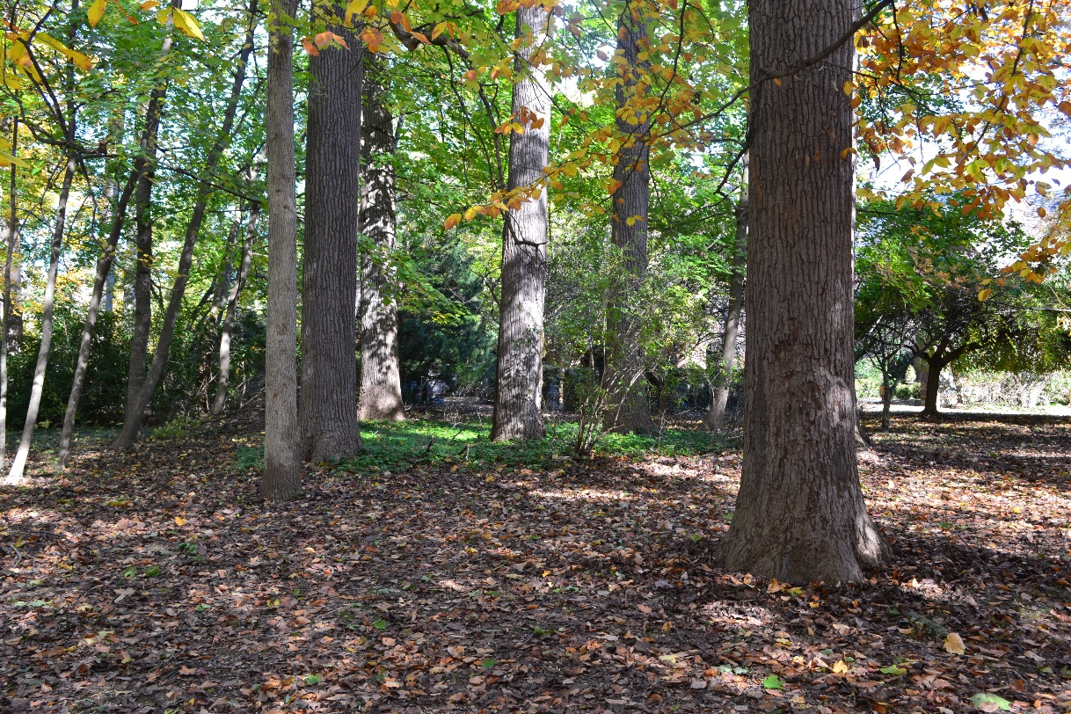
Ecological corridor

Slide 5
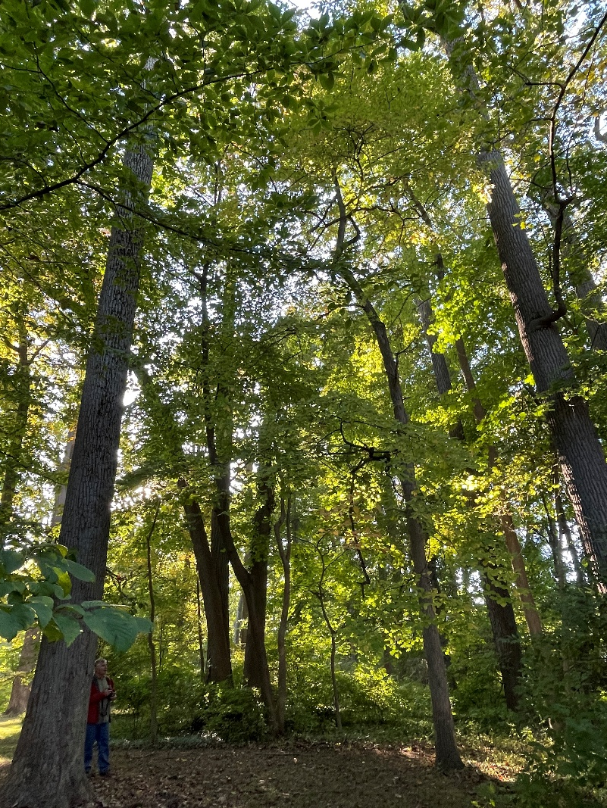
Ecological corridor

Slide 6
Watershed impact
Every single waterbody in Lower Merion is considered impaired by the EPA
Removal of 500+ trees will have local and further reaching impacts
Notes:
Every single waterbody in Lower Merion is considered impaired by the EPA. This includes degraded habitat, PCBs, and sediment from urban runoff.
The Oakwell site includes a wetland near the headwaters of several waterbodies, including Hardings Run, connecting to the Delaware River watershed, as well as unnamed tributaries to Mill Creek, and a tributary to Gulph Creek leading to the Schuylkill River watershed.

